Slide 1
CẤU TRÚC DỮ LIỆU VÀ GIẢI THUẬT
BÀI 3: GIẢI THUẬT THAM LAM
Giảng viên: nguyenmanhson@gmail.com

Slide 2
Nội dung
Giới thiệu giải thuật tham lam
Một số bài toán áp dụng giải thuật tham lam
  Making Change
  Traveling salesman problem
  Linear programming
  Project management
  0/1 knapsack problem

Slide 3
Greedy algorithms
Suppose it is possible to build a solution through a sequence of partial solutions
  At each step, we focus on one particular partial solution and we attempt to extend that solution
  Ultimately, the partial solutions should lead to a feasible solution which is also optimal

Slide 4
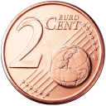

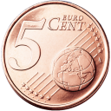
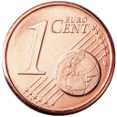
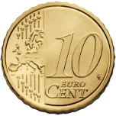
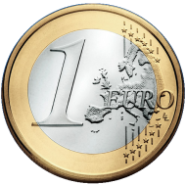
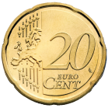
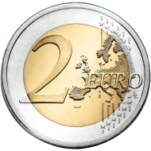
Making change
Consider this commonplace example:
  Making the exact change with the minimum number of coins
  Consider the Euro denominations of 1, 2, 5, 10, 20, 50 cents
  Stating with an empty set of coins, add the largest coin possible into the set which does not go over the required amount

Slide 5
Making change
To make change for €0.72:
  Start with €0.50
Total €0.50

Slide 6
Making change
To make change for €0.72:
  Start with €0.50
  Add a €0.20
Total €0.70

Slide 7
Making change
To make change for €0.74:
  Start with €0.50
  Add a €0.20
  Skip the €0.10 and the €0. 05 but add a €0.02
Total €0.72

Slide 8
Making change
Notice that each digit can be worked with separately
  The maximum number of coins for any digit is three
  Thus, to make change for anything less than €1 requires at most six coins
  The solution is optimal

Slide 9
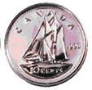
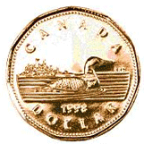
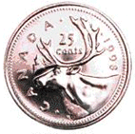

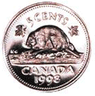

Making change
To make change for 0.72¢ requires six Canadian coins
  However, we have only four coins less than $1
  This is still, however, optimal

Slide 10
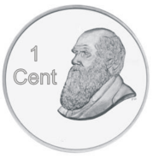


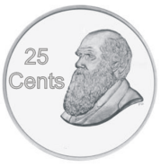
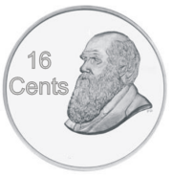


Making change
Does this strategy always work?
  What if our coin denominations grow quadraticly?
  Consider 1, 4, 9, 16, 25, 36, and 49 dumbledores
Reference: J.K. Rowlings, Harry Potter, Raincoast Books, 1997.

Slide 11
Making change
Using our algorithm, to make change for 72 dumbledores, we require six coins:
  72 = 49 + 16 + 4 + 1 + 1 + 1

Slide 12
Making change
The optimal solution, however, is two 36 dumbledore coins

Slide 13
Definition
A greedy algorithm is an algorithm which has:
  A set of partial solutions from which a solution is built
  An objective function which assigns a value to any partial solution
Then given a partial solution, we
  Consider possible extensions of the partial solution
  Discard any extensions which are not feasible
  Choose that extension which minimizes the object function
This continues until some criteria has been reached

Slide 14
Optimal example
Prim’s algorithm is a greedy algorithm:
  Any connected sub-graph of k vertices and k – 1 edges is a partial solution
  The value to any partial solution is the sum of the weights of the edges
Then given a partial solution, we
  Add that edge which does not create a cycle in the partial solution and which minimizes the increase in the total weight
  We continue building the partial solution until the partial solution has n vertices
  An optimal solution is found

Slide 15
Optimal example
Dijkstra’s algorithm is a greedy algorithm:
  A subset of k vertices and known the minimum distance to all k vertices is a partial solution
Then given a partial solution, we
  Add that edge which is smallest which connects a vertex to which the minimum distance is known and a vertex to which the minimum distance is not known
  We define the distance to that new vertex to be the distance to the known vertex plus the weight of the connecting edge
  We continue building the partial solution until either:
    The minimum distance to a specific vertex is known, or
    The minimum distance to all vertices is known
  An optimal solution is found

Slide 16
Optimal and sub-optimal examples
Our coin change example is greedy:
  Any subset of k coins is a partial solution
  The value to any partial solution is the sum of the values
Then given a partial solution, we
  Add that coin which maximizes the increase in value without going over the target value
We continue building the set of coins until we have reached the target value
An optimal solution is found with euros and cents, but not with our quadratic dumbledore coins
  It fails 29 out of 99 times:
  12 18 19 22 23 32 41 42 43 48 52 56 61 64 67
  68 70 71 72 73 76 77 80 81 88 90 91 92 97

Slide 17
Optimal and sub-optimal examples
An implementation of the greedy algorithm is straight-forward:
    void greedy( int value, int *coins, int *rep, int n ) {
    for ( int i = n - 1; i >= 0; --i ) {
    rep[i] = 0;
    while ( coins[i] <= value ) {
    value -= coins[i];
    ++( rep[i] ); //++rep[i] also works
    }
    }
    }

Slide 18
Optimal and sub-optimal examples
Determining whether n denominations of coins will allow a greedy algorithm to minimize change is difficult—there are no easy rules
  The Pearson test is an O(n³) algorithm which returns either 0 or a value for which the greedy algorithm fails
    int pearson( int *coins, int n ) {
    int m = 0, rep1[n], rep2[n];
    for ( int j = 0; j < n - 2; ++j ) {
    for ( int i = j; i < n - 2; ++i ) {
    greedy( coins[i + 1] - 1, coins, rep1, n );
    ++( rep1[j] );
    for ( int k = 0; k < j - 2; ++k ) rep1[k] = 0;
    int r = 0; for ( int k = 0; k < n; ++k ) r += rep1[k]*coins[k];
    if ( m == 0 || r < m ) {
    greedy( r, coins, rep2, n );
    int sum1 = 0; for ( int k = 0; k < n; ++k ) sum1 += rep1[k];
    int sum2 = 0; for ( int k = 0; k < n; ++k ) sum2 += rep2[k];
    if ( sum2 > sum1 ) {
    m = r;
    }
    }
    }
    }
    return m;
    }

Slide 19
Unfeasible example
In some cases, it may be possible that not even a feasible solution is found
  Consider the following greedy algorithm for solving Sudoku:
  For each empty square, starting at the top-left corner and going across:
    Fill that square with the smallest number which does not violate any of our conditions
    All feasible solutions have equal weight

Slide 20
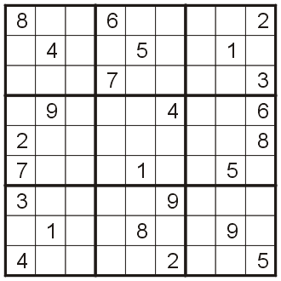
Unfeasible example
Let’s try this example the previously seen Sudoku square:

Slide 21
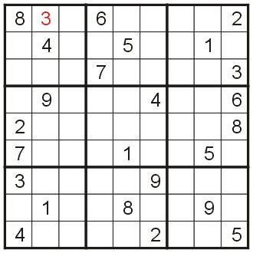
Unfeasible example
Neither 1 nor 2 fits into the first empty square, so we fill it with 3

Slide 22
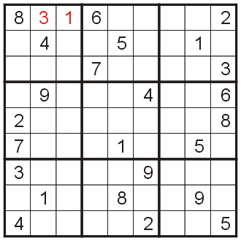
Unfeasible example
The second empty square may be filled with 1

Slide 23
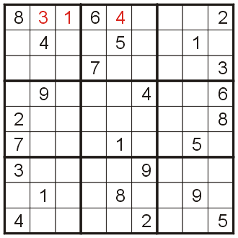
Unfeasible example
And the 3rd empty square may be filled with 4

Slide 24
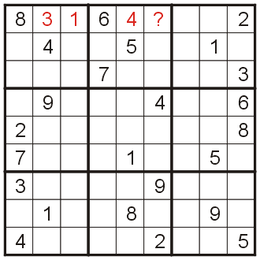
Unfeasible example
At this point, we try to fill in the 4th empty square

Slide 25
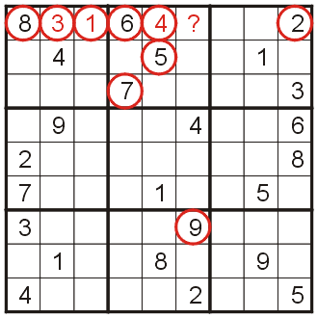
Unfeasible example
Unfortunately, all nine numbers 1 – 9 already appear in such a way to block it from appearing in that square
  There is no known greedy algorithm which finds the one feasible solution

Slide 26
Traveling salesman problem
Suppose you want to cycle through n cities without visiting the same city twice
The Traveling Salesman Problem
  It is possible to go from any one city to another
The nearest neighbor algorithm is greedy:
  Go to the closest city which has not yet been visited
This will find a solution, but it is unlikely to be optimal
  Reasonable with Euclidean distances
    With random distributions of cities, on average the solution is 125 % of the optimal solution
  It can be made to find the worst possible path with constructed examples for non-Euclidean distances

Slide 27
Optimal substructure
Can we ever prove that a greed algorithm will work efficient?
A problem has an optimal substructure if an optimal solution can be constructed efficiently from optimal solutions of its sub-problems

Slide 28
Near-optimal algorithms
We have seen:
  A greedy change algorithm which works under certain conditions
  Prim’s and Dijkstra’s algorithms which are greedy and find the optimal solution
  A naïve greedy algorithm which attempts (and fails) to solve Sudoku
  The nearest neighbor algorithm is unlikely to find the optimal solution
Next, we will see a greedy algorithm which finds a feasible, but not necessarily an optimal, solution

Slide 29
Project management
0/1 knapsack problem
Situation:
  The next cycle for a given product is 26 weeks
  We have ten possible projects which could be completed in that time, each with an expected number of weeks to complete the project and an expected increase in revenue
This is also called the 0/1 knapsack problem
  You can place n items in a knapsack where each item has a value in rupees and a weight in kilograms
  The knapsack can hold a maximum of m kilograms

Slide 30
Project management
0/1 knapsack problem
Objective:
  As project manager, choose those projects which can be completed in the required amount of time which maximizes revenue

Slide 31
Project management
0/1 knapsack problem
The projects:
Product ID | Completion Time (wks) | Expected Revenue (1000 $)
A | 15 | 210
B | 12 | 220
C | 10 | 180
D | 9 | 120
E | 8 | 160
F | 7 | 170
G | 5 | 90
H | 4 | 40
J | 3 | 60
K | 1 | 10

Slide 32
Project management
0/1 knapsack problem
Let us first try to find an optimal schedule by trying to be as productive as possible during the 26 weeks:
  we will start with the projects in order from most time to least time, and at each step, select the longest-running project which does not put us over 26 weeks
  we will be able to fill in the gaps with the smaller projects

Slide 33
Project management
0/1 knapsack problem
Greedy-by-time (make use of all 26 wks):
  Project A: 15 wks
  Project C: 10 wks
  Project J: 1 wk
Total time: 26 wks
Expected revenue:
  $400 000
Product ID | Completion Time (wks) | Expected Revenue (1000 $)
A | 15 | 210
B | 12 | 220
C | 10 | 180
D | 9 | 120
E | 8 | 160
F | 7 | 170
G | 5 | 90
H | 4 | 40
I | 3 | 60
J | 1 | 10

Slide 34
Project management
0/1 knapsack problem
Greedy-by-revenue (best-paying projects):
  Project B: $220K
  Project C: $180K
  Project H: $ 60K
  Project K: $ 10K
Total time: 26 wks
Expected revenue:
  $470 000
Product ID | Completion Time (wks) | Expected Revenue (1000 $)
B | 12 | 220
A | 15 | 210
C | 10 | 180
F | 7 | 170
E | 8 | 160
D | 9 | 120
G | 5 | 90
J | 3 | 60
H | 4 | 40
K | 1 | 10

Slide 35
Project management
0/1 knapsack problem
Unfortunately, either of these techniques focuses on projects which have high projected revenues or high run times
What we really want is to be able to complete those jobs which pay the most per unit of development time
Thus, rather than using development time or revenue, let us calculate the expected revenue per week of development time

Slide 36
Project management
0/1 knapsack problem
This is summarized here:
Product ID | Completion Time (wks) | Expected Revenue (1000 $) | Revenue Density ($ / wk)
A | 15 | 210 | 14 000
B | 12 | 220 | 18 333
C | 10 | 180 | 18 000
D | 9 | 120 | 13 333
E | 8 | 160 | 20 000
F | 7 | 170 | 24 286
G | 5 | 90 | 18 000
H | 4 | 40 | 10 000
J | 3 | 60 | 20 000
K | 1 | 10 | 10 000

Slide 37
Project management
0/1 knapsack problem
Greedy-by-revenue-density:
  Project F: $24 286/wk
  Project E: $20 000/wk
  Project J: $20 000/wk
  Project G: $18 000/wk
  Project K: $10 000/wk
Total time: 24 wks
Expected revenue:
  $490 000
Bonus: 2 weeks for bug fixing
Product ID | Completion Time (wks) | Expected Revenue (1000 $) | Revenue Density ($/wk)
F | 7 | 170 | 24 286
E | 8 | 160 | 20 000
J | 3 | 60 | 20 000
B | 12 | 220 | 18 333
C | 10 | 180 | 18 000
G | 5 | 90 | 18 000
A | 15 | 210 | 14 000
D | 9 | 120 | 13 333
H | 4 | 40 | 10 000
K | 1 | 10 | 10 000

Slide 38
Project management
0/1 knapsack problem
Using brute force, we find that the optimal solution is:
  Project C: $180 000
  Project E: $170 000
  Project F: $150 000
  Project K: $ 10 000
Total time: 26 wks
Expected revenue:
  $520 000
Product ID | Completion Time (wks) | Expected Revenue (1000 $) | Revenue Density ($/wk)
A | 15 | 210 | 14 000
B | 12 | 220 | 18 333
C | 10 | 180 | 18 000
D | 9 | 120 | 13 333
E | 8 | 160 | 20 000
F | 7 | 170 | 24 286
G | 5 | 90 | 18 000
H | 4 | 40 | 10 000
J | 3 | 60 | 20 000
K | 1 | 10 | 10 000

Slide 39
Project management
0/1 knapsack problem
In this case, the greedy-by-revenue-density came closest to the optimal solution:
  The run time is Θ(n ln(n)) — the time required to sort the list
  Later, we will see a dynamic program for finding an optimal solution with one additional constraint
Algorithm | Expected Revenue
Greedy-by-time | $400 000
Greedy-by-expected revenue | $470 000
Greedy-by-revenue density | $490 000
Brute force | $520 000

